Slide 1
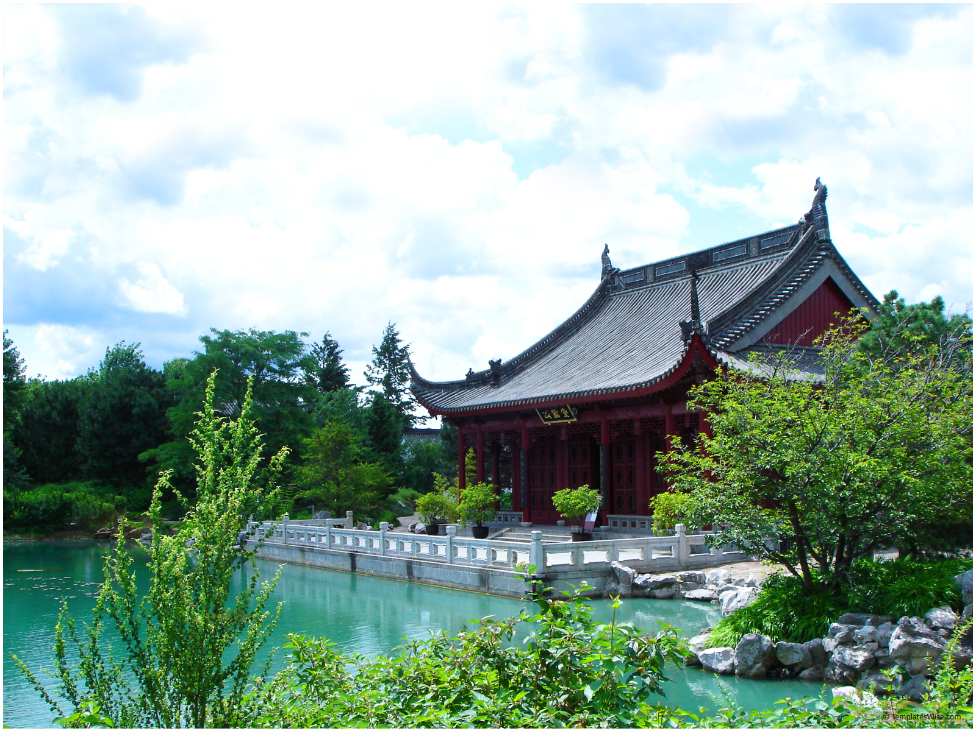

FOTILE’s Next Steps
Infusing Confucian values into the conventional management practices
Fusion Consulting
Bobby Mulligan, Danny Kim, Kido Park, Lesley Lin

Slide 2
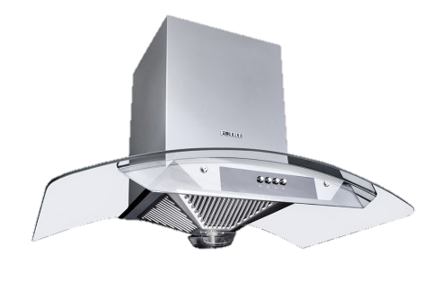
Agenda
Overview
One Culture
Greater Good
Strategic Move
Implementation Timeline
FOTILE’s Next Steps
Appendices
Notes:
May require more than one slide

Slide 3
Overview: FOTILE’s steps to becoming the premier global business
One Culture
Greater Good
Strategic Move
Unclear, sometimes conflicting values limit the market growth, customer service quality, and employee motivation
Bottleneck for growth arises from increasing competition, difficulty of getting new talent, and limited R&D investment
FOTILE has technological and resource capability to leverage its position strategically to achieve further growth and its mission
Situation
Redefine company values and align every constituent to resonate
Sustain competitive advantage in technology and marketing
Become a premier global business and promote Confucian values
Challenge
Build Confucius Institute into the heart of company’s culture
Motivate employees through effective HR policies
Recruit and inject new talent for fresh ideas
Promote corporate social responsibility
Form strategic alliance with shared values
Expand into international markets
Solution
FOTILE’s Vision: To become a Premier Global Business
Notes:
May require more than one slide

Slide 4
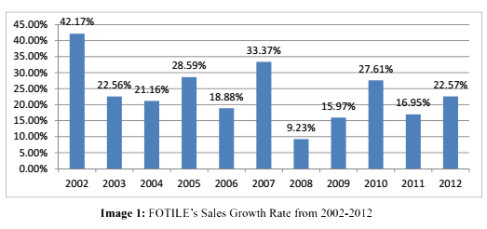
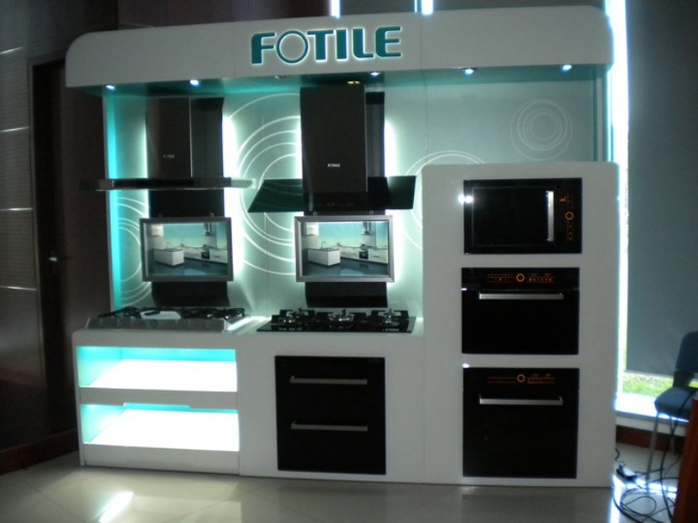
FOTILE’s competitive advantages and limitations
Key Sources of Success
Limiting Factors
Technological innovation: More than 300 patents and huge investments in R&D
Strong brand positioning: Products aimed at high-end, high-margin market segment; FOTILE & FOTILE BORCCI
Effective marketing strategy: Successful advertising campaign and competitive marketing staff
Low motivation for growth and competition
Unfair/harsh management practices
Lack of coherence of company values across the teams
One Culture
Greater Good
Strategic Move
Notes:
May require more than one slide

Slide 5
Redefining company values: what Confucianism says about profits and business growth?
Be considerate of others; profit maximization is minimization for others
Deliver more of better product and customer experience; raise the bar
Humaneness
Strictly follow established rules and guidelines at all circumstances
Rules are only justified through the fairly reached consensus of the related people
Justice
Need an institutional body to impose moral values and govern the people for compliance
Consists of self-motivated people that share the same values to achieve greater good
Etiquette /
Institution
“One who, on seeing profit, thinks of righteousness, may be considered a perfect man.”
= Profit-making in harmony with the good of the society
Source: “Catholicism and Confucianism in Dialogue for Corporate Social Responsibility”
Research paper by Han
One Culture
Greater Good
Strategic Move
Notes:
May require more than one slide

Slide 6
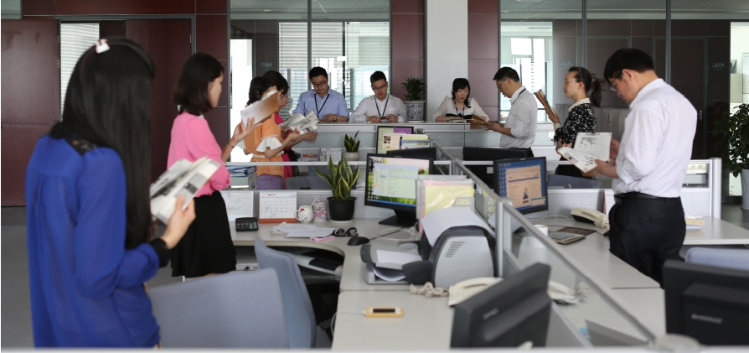
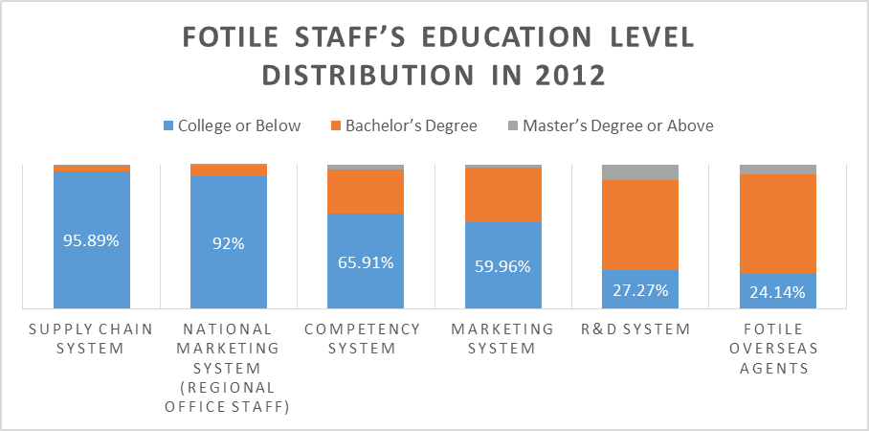
Build Confucius Institute into the heart of company’s culture
What It Serves
Benefits
Regular (quarterly) training sessions for all employees
Additional function: FOTILE University for educating the community and prospective hires
Offering opportunities for marketing staff to experience higher level education
Better training leads to better job performance and increase customer satisfaction
Relate more growth opportunities to advance within the organization; regional manager
More frequent and open interaction amongst different functions
One Culture
Greater Good
Strategic Move
Notes:
May require more than one slide

Slide 7


Motivate employees through effective HR policies
Changes to be Made
Benefits
ABC appraisal adopts an absolute scale from a relative scale
More objective criteria are reflected in the job appraisal
Grade of C doesn’t imply straight job dismissal and an improving
Dividend bonuses are linked to job evaluation (A-100%, B-50%, C-20% of monthly salary)
Everyone can get an A and there doesn’t have to be a C
Reduces competition against colleagues and more objective criteria reflected in assessment
Poor performance isn’t the final call but still encourages improvement through different bonus payment
One Culture
Greater Good
Strategic Move
Notes:
May require more than one slide

Slide 8
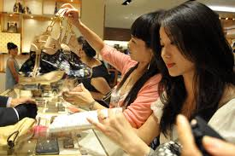
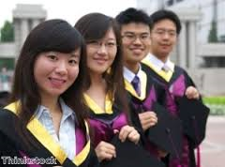


Harmony with the good of the society: FOTILE’s stakeholders
FOTILE’s External Stakeholders
 | Stakeholder | Current Relationship
 | Customers | Most advanced customer services in the nation
 | Business partners / competitors | Big market share and technology leader
 | Community | Little contributions made to the community
 | College / Prospective hires | Limited access to the new talent
“Endless pursuit of technological breakthroughs for more effective fume removal”
– case material
FOTILE can spread its Confucian values more widely through delivering higher quality products and customer services to its customers as well as leveraging its position to reach other stakeholders
One Culture
Greater Good
Strategic Move
Notes:
May require more than one slide

Slide 9
Recruit and inject new talent for fresh ideas
Build mutually beneficial relationships with universities in major cities
Offer guest lecture series regarding Confucianism and FOTILE’s business philosophy
Sponsor case competitions and idea pitching events to gain fresh R&D ideas and spot bright prospective hires
Provide scholarship and internship opportunities to bright talents to attract them from early on
Beijing
(Beijing University, Tsinghua University)
Shanghai
(Shanghai University)
Headquarters
(Ningbo)
FOTILE University
Expand the facility to serves as a hub for training employees all across the nation as well as prospective hires and college-related programs
Provide students with more on-the-job experience to give them chance to assess the cultural fit
One Culture
Greater Good
Strategic Move
Notes:
May require more than one slide

Slide 10


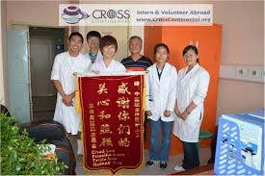
Promote corporate social responsibility
Make more contributions back to the community
Open up FOTILE University to the public who are interested in Confucianism
Offer special classes in Confucianism within business context and special interests
Host special sessions where both the employees and their families (especially children) can enjoy learning the common values
Connect with local nonprofits for charity
Create volunteer work days where employees can take regular work days off to volunteer in community services
FOTILE University for Public
Family Involvement
Volunteer Work Days
Greatly increases employee morale and work satisfaction through linking the company’s business performance with bigger give-backs to the community
Helps in the long-run publicity of the company and building of strong goodwill with potential customers
One Culture
Greater Good
Strategic Move
Notes:
May require more than one slide

Slide 11
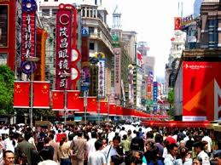

Current boom of traditional values in China
Increasing importance of traditional values
Benefits
Consumers are increasingly becoming socially conscious consumers and make more ethical considerations in deciding purchases
Chinese government is seeking to establish greater Chinese business associations in the face of intense foreign competition
Gain supports from Chinese government to enable alliances within the industry
Create much stronger brand images that can further benefit company’s sales.
Foster the opportunities to expand into other countries
One Culture
Greater Good
Strategic Move
Notes:
May require more than one slide

Slide 12

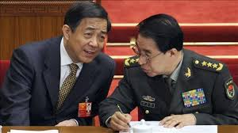
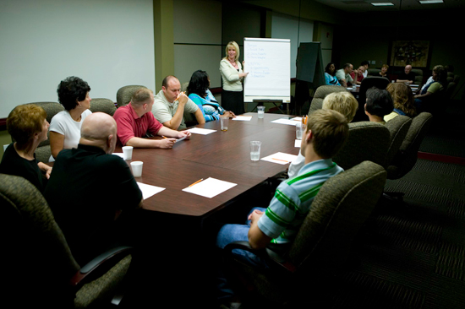
Form strategic alliance with shared values
Candidates for the strategic alliance
FOTILE’s roles
 | Candidates | Strategic Alliance
 | Competitors in the kitchen appliance industry as well as wider consumer appliance industry
 | Nonprofits and consumer interest groups that advocate the common values like FOTILE
 | Target for official recognition from regulatory government agency
Persuade business partners to join and share the common values through Confucian education
Establish a code of ethics and guiding standards for all alliance members
Launch a collective marketing scheme to promote the value of the alliance and establish association of its membership with socially responsible companies producing high quality products
One Culture
Greater Good
Strategic Move
Notes:
May require more than one slide

Slide 13
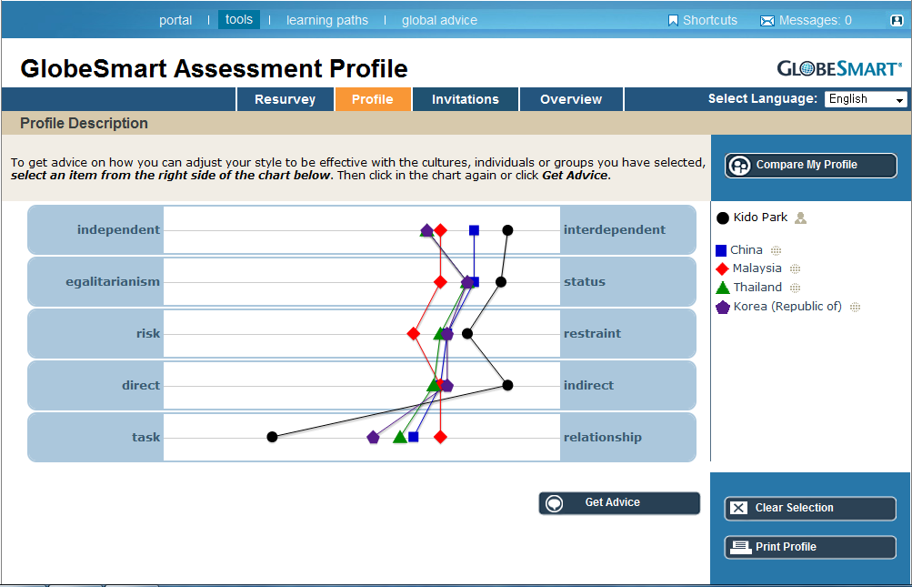




Expand into international markets
Identification of culturally similar markets
Closer geographic proximity and within the influence of domestic marketing efforts
Easier to connect to their cultural values with FOTILE’s Confucian values and spread the company’s philosophy to bigger audience
Niche market present for high-end products of kitchen appliances
One Culture
Greater Good
Strategic Move
Notes:
May require more than one slide

Slide 14
Implementation Timeline
Year 1
Year 2
Year 3
Year 4
Year 5
Improve training program and create FOTILE university
Modify ABC praising scale
to create new incentive plan
Cooperate with Chinese universities for the Talented Hiring
Launch the alliance project with companies that share similar ideology
One Culture
Greater Good
Strategic Move

Slide 15
FOTILE’s Next Steps
Vision: Premier Global Business
Chinese-style Management
Key Focus Areas
Sustainability of the technological innovation
Resonating message in the sales force
Blend Confucian values with Western ideology
FOTILE proceeds to become the premier business leader
Notes:
May require more than one slide

Slide 16
?
Questions
Notes:
May require more than one slide

Slide 17
Appendix 1: Major Problem Areas
Confucius Institute
Half-voluntary?
External pressure
Measure of understanding
Labor Share System
20% of profits
Helping efficiency?
Extrinsic vs. Intrinsic
Market Share Focus
Best Service Principle
Hinder motivation
Intense competition
International market
Unclear guideline
Customer satisfaction
Job Appraisal
Geographical distance
Lack of interaction with the headquarters
Inconsistent cultural resonance
Seeking New Talent
Distant Marketing Team
ABC appraisal for fairness
Last chances granted for improvement
Consideration for R&D team
Industry-competitive salary
Staff poaching
Access to highly-educated candidates
Notes:
May require more than one slide

Slide 18
Appendix 2: Financial Projection
Notes:
May require more than one slide

Slide 19
Appendix 2: Financial Projection
Notes:
May require more than one slide

Slide 20
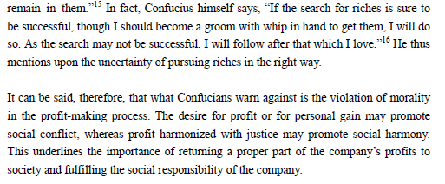
Confucianism in China
Appendix 3: Sources for Confucian Values
press.princeton.edu/chapters/s9173.pdf
https://www.stthomas.edu/cathstudies/cst/conferences/thegoodcompany/Finalpapers/Hong%20Soon%20Han%20Final%20.pdf

Slide 21
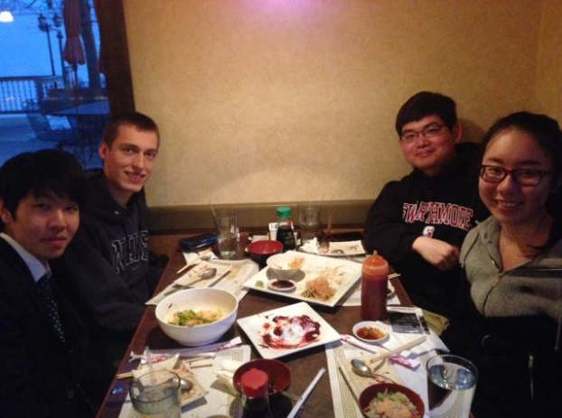
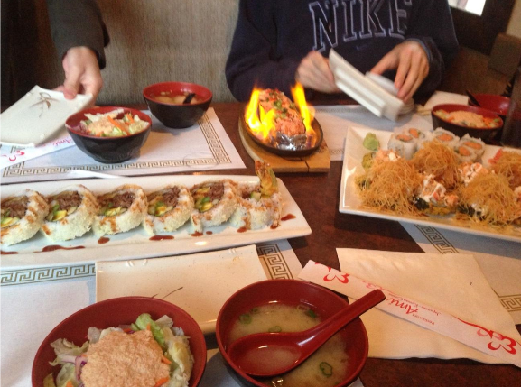
Appendix 4: Our Team Experience
Getting to Know Each Other
Notes:
May require more than one slide

Slide 22
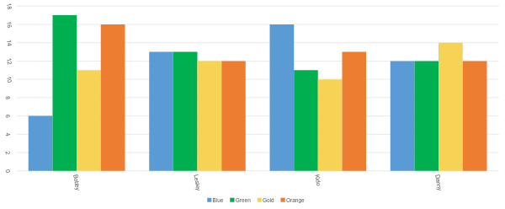
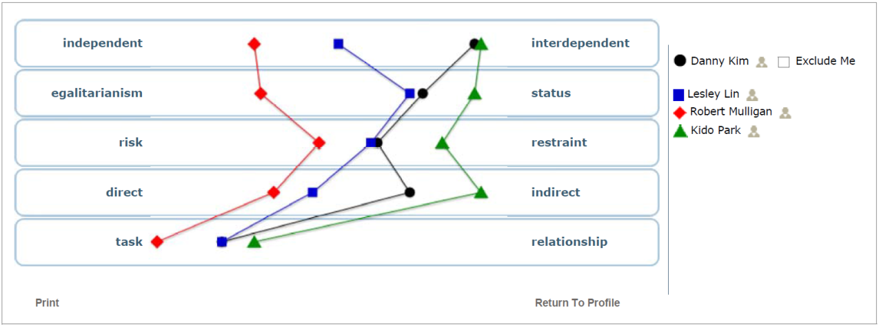
Appendix 4: Our Team Experience
True Color Indicator Test
1 Green, 1 Green/Blue,
1 Blue, 1 Gold
GlobeSmart Team Analysis
Evenly spread from left to right, but all Task-Oriented
Notes:
May require more than one slide

Slide 23
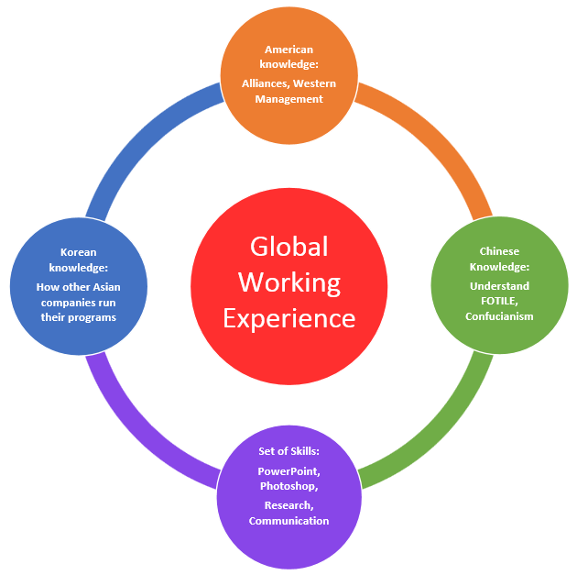
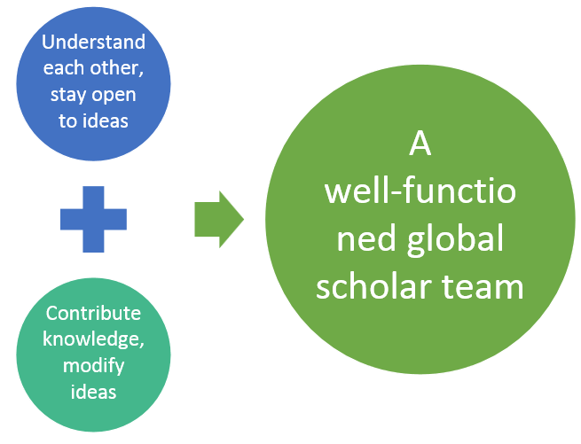
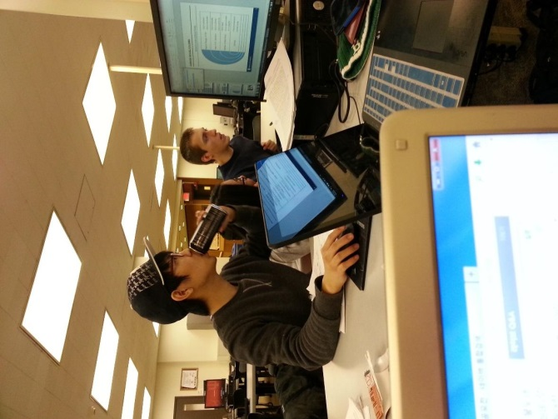
Appendix 4: Our Team Experience
Working as a Team
What We Learned
Notes:
May require more than one slide

